Slide 1
What is AKS?
WorkshopPlus – Kubernetes Tech Briefing

Slide 2
Conditions and terms of use
© Microsoft Corporation. All rights reserved.
You may use these training materials solely for your personal internal reference and non-commercial purposes. You may not distribute, transmit, resell or otherwise make these training materials available to any other person or party without express permission from Microsoft Corporation. URL’s or other internet website references in the training materials may change without notice. Unless otherwise noted, any companies, organizations, domain names, e-mail addresses, people, places and events depicted in the training materials are for illustration only and are fictitious. No real association is intended or inferred. THESE TRAINING MATERIALS ARE PROVIDED “AS IS”; MICROSOFT MAKES NO WARRANTIES, EXPRESS OR IMPLIED IN THESE TRAINING MATERIALS¹

Slide 3

Topics
 | Components and Features
 | Tiers and offerings
 | Add-ons and Extensions

Slide 4
Components and Features

Slide 5
What is AKS?
Managed Kubernetes Service on Azure used to deploy and manage containerized workloads
Reduces operational overhead of managing Kubernetes by offloading much of that to Azure
High level features
  High availability
  Scalability
  Portability
  OSS Integration
Notes:
Talk about what AKS automates for the Kubernetes piece and how it make is simpler to manage vs open source k8s.
Also a good point to compare against other Azure container offerings like:
Azure Red Hat Openshift
Azure Container Instances
Azure Container Apps
App Service

Slide 6
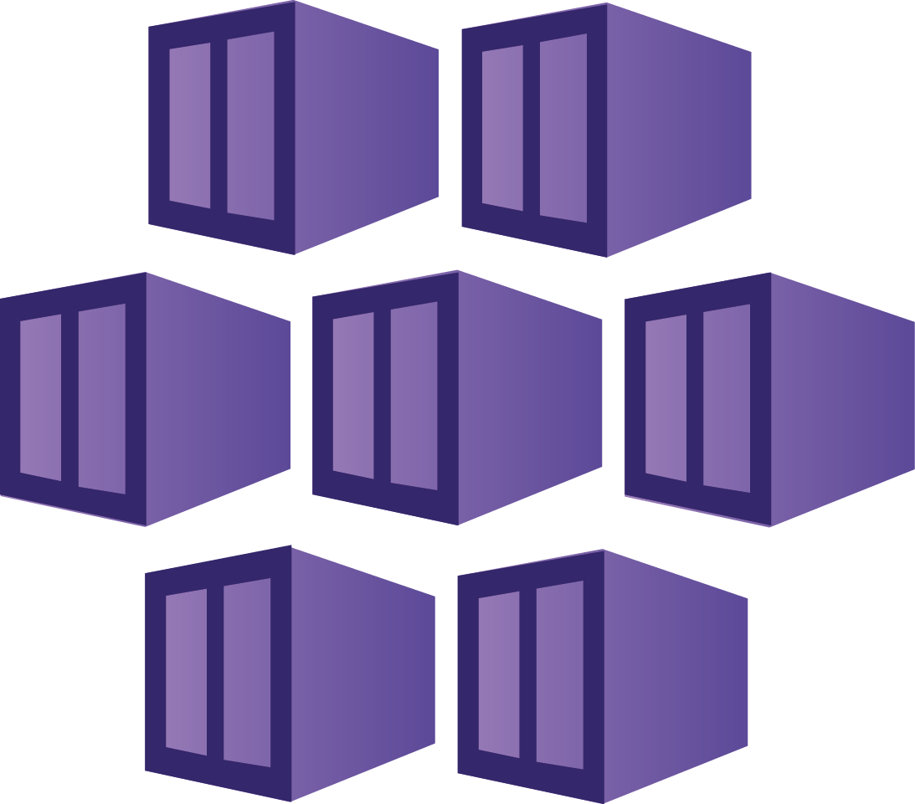
When to use it
Lift and Shift to AKS
Microservices on AKS
Secure DevOps
Burstable workloads using ACI
Machine Learning on AKS
Data streaming with AKS
Windows Containers on AKS
LLMs on AKS using Kubernetes AI Toolchain Operator (Kaito)
Notes:
The following list describes some common use cases for AKS:
Lift and shift to containers with AKS: Migrate existing applications to containers and run them in a fully managed Kubernetes environment.
Microservices with AKS: Simplify the deployment and management of microservices-based applications with streamlined horizontal scaling, self-healing, load balancing, and secret management.
Secure DevOps for AKS: Efficiently balance speed and security by implementing secure DevOps with Kubernetes.
Bursting from AKS with ACI: Use virtual nodes to provision pods inside ACI that start in seconds and scale to meet demand.
Machine learning model training with AKS: Train models using large datasets with familiar tools, such as TensorFlow and Kubeflow.
Data streaming with AKS: Ingest and process real-time data streams with millions of data points collected via sensors, and perform fast analyses and computations to develop insights into complex scenarios.
Using Windows containers on AKS: Run Windows Server containers on AKS to modernize your Windows applications and infrastructure.

Slide 7
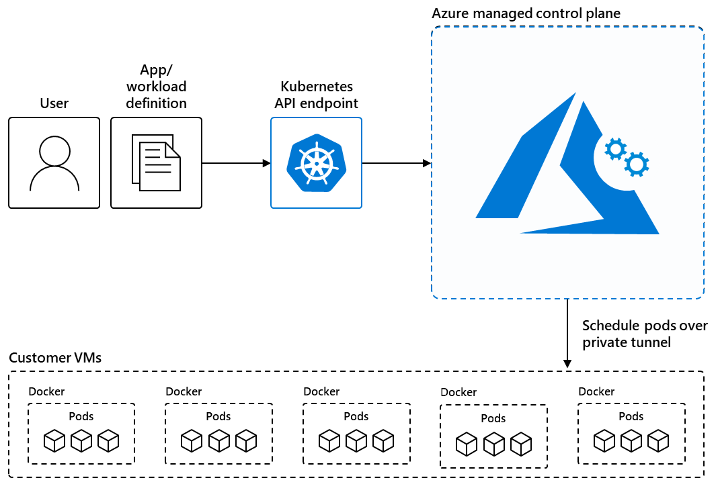
Components
Notes:
Talk about the different AKS components like the Control plane, worker nodes and how they work in AKS vs Standard Kubernetes
What AKS does to make it easier to use

Slide 8
Features
Identity and Security Management
Logging and Monitoring
Streamlined Deployments
Clusters and Nodes
Storage and Volume Support
Networking
Development Tool integration
Notes:
Identity and security management• Enforce regulatory compliance controls using Azure Policy with built-in guardrails and internet security benchmarks.
• Integrate with Kubernetes RBAC to limit access to cluster resources.
• Use Microsoft Entra ID to set up Kubernetes access based on existing identity and group membership.
Logging and monitoring• Integrate with Container Insights, a feature in Azure Monitor, to monitor the health and performance of your clusters and containerized applications.
• Set up Advanced Container Networking Services to collect and visualize network traffic data from your clusters.
Streamlined deployments• Use prebuilt cluster configurations for Kubernetes with smart defaults.
• Autoscale your applications using the Kubernetes Event Driven Autoscaler (KEDA).
• Use Draft for AKS to ready source code and prepare your applications for production.
Clusters and nodes• Connect storage to nodes and pods, upgrade cluster components, and use GPUs.
• Create clusters that run multiple node pools to support mixed operating systems and Windows Server containers.
• Configure automatic scaling using the cluster autoscaler and horizontal pod autoscaler.
• Deploy clusters with confidential computing nodes to allow containers to run in a hardware-based trusted execution environment.
Storage volume support• Mount static or dynamic storage volumes for persistent data.
• Use Azure Container Storage for fully managed, cloud-based volume management and orchestration of block storage. Azure Container Storage integrates with Kubernetes, allowing dynamic and automatic provisioning of persistent volumes.
• Use Azure Disks CSI driver for single pod access and Azure Files CSI driver for multiple, concurrent pod access.
• Use Azure NetApp Files for high-performance, high-throughput, and low-latency file shares.
Networking• Leverage our networking options for your needs.
• Bring your own Container Network Interface (CNI) to use a third-party CNI plugin.
• Easily access applications deployed to your clusters using the application routing add-on with nginx.
Development tooling integration• Develop on AKS with Helm.
• Install the Kubernetes extension for Visual Studio Code to manage your workloads.
• Leverage the features of Istio with the Istio-based service mesh add-on.

Slide 9
Tiers and offerings

Slide 10
AKS Standard and AKS Automatic
AKS Standard
  Delivers manual configuration with advanced controls
  Full control over the provisioned AKS cluster with Control plane automation
  Customer managed
    Node pools, Networking, Security, Upgrades
    Monitoring and logging
AKS Automatic
Removes much of the operational complexity that AKS brings
  Less customization compared to AKS Standard
  Automated components
    Node Pool management, Networking, Security, Cluster Upgrades
    Built-in Monitoring: Managed Prometheus and Grafana with Container Insights
  Lower operational overhead
Notes:
AKS Automatic
Fully managed version of AKS designed to tackle a lot of the complexities around managing AKS
Less Customization compared to Standard AKS
Deploys with best practices enabled by default
Automated Cluster management
Built-in Monitoring and Logging
Lower Operation Overhead
AKS Feature Comparison (Standard vs Automatic)

Slide 11
Deploying AKS
Delivers a highly customizable cluster that will need to be setup to follow best practices for a secure cluster that meets organizational security and compliance needs
How?
  AKS Azure Landing Zone Accelerator
    Scenarios
  Deployable
    Terraform
    Portal
    Azure CLI
    Bicep
  Highly recommended to leverage delivered terraform modules or Bicep code when deploying clusters

Slide 12
Supported Versions
AKS follows 12 months of support from a release of a GA Kubernetes version release
  AKS Release Calendar
Releases follow the Kubernetes releases
  New minor versions every 4 months
  Standard version support is one year from GA
AKS Long term Support
  Introduced to provide a long term support option for less upgrades on a supported AKS version
  2 years of support on a version of AKS
  Requires a premium tier cluster

Slide 13
Add-ons and Extensions

Slide 14
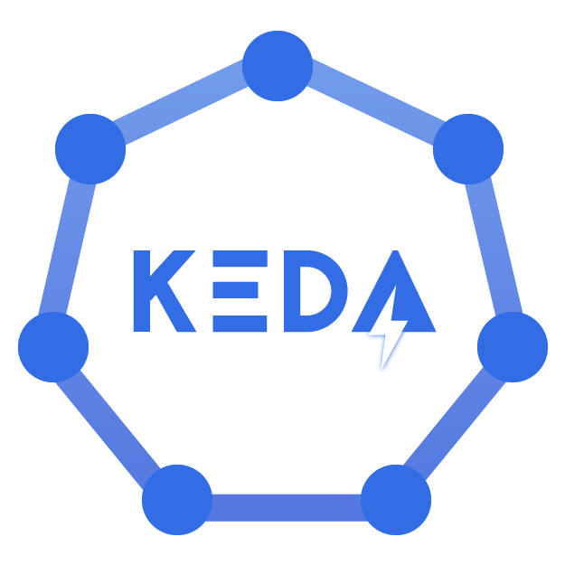


Add-ons
Fully supported way to provide extra capabilities to AKS
Fully managed by AKS
Available Add-ons
  KEDA
  Monitoring
  Virtual Node
  Kube dashboard
  Azure policy
  Ingress-appgw (AGIC)
  Gitops
  Web application routing

Slide 15

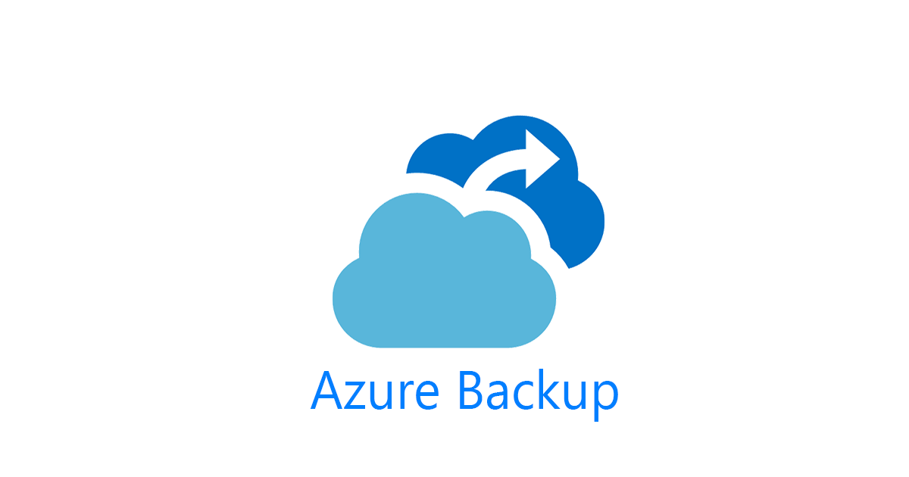
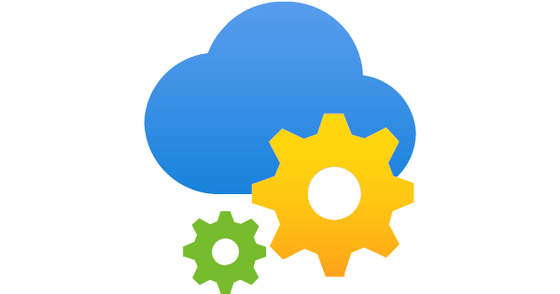
Extensions
Dapr
Azure App Configuration
Azure Machine Learning
Flux
Azure Container Storage
Azure Backup for AKS

Slide 16


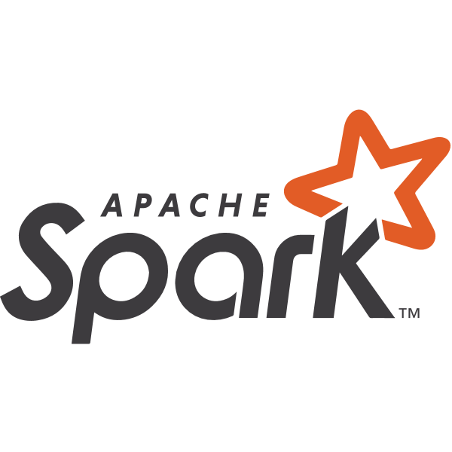

3rd party and Open source integrations
Helm
Prometheus – Managed Experience available
Grafana – Managed Experience available
Couchbase
OpenFaaS
Apache Spark
Istio
Linkerd
Consul

Slide 17
Demo
Deploying a AKS Cluster Standard
Deploying an AKS Automatic cluster
Notes:
Demo what a standard delivered cluster comes with out of the box and the configarations that need to be done to make it secure. Talk about the AKS LZA private baseline cluster that is linked in the earlier slides
Demo what AKS automatic is and what problems it solves and how it makes AKS simple compared to the fully customizable solution

Slide 18
Questions?

Slide 19
Lab: What is AKS?
Lab Description
Deploying a AKS Cluster
Deploying a AKS Automatic Cluster
Notes:
Link to lab: https://labondemand.com/LabProfile/
##########

